Slide 1
DevOps
Lesson 02- GIT
Notes:
Add instructor notes here.

Slide 2
Lesson Objectives
Introduction to GIT
Version Control
Repositories and Branches
Working Locally with GIT
Working Remotely with GIT
Notes:
Add instructor notes here.

Slide 3
Introduction to Git Introduction
Initially developed by Linus Torvalds, Git is a distributed version control system
Git is a distributed revision control and source code management (SCM) system with an emphasis on speed, data integrity and support for distributed, non-linear workflows
As with most other distributed revision control systems, and unlike most client–server systems, every Git working directory is a full-fledged repository with complete history and full version-tracking capabilities, independent of network access or a central server. Like the Linux kernel, Git is free software distributed under the terms of the GNU General Public License version 2
Notes:
Add the notes here.
Add instructor notes here.

Slide 4
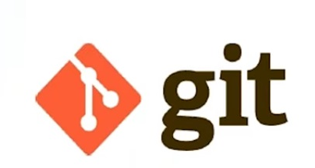
Introduction to Git Introduction
Design Philosophy
Free & Open Source
Blazingly Fast
Distributed
Data Assurance
Strong support for non-linear development
Compatibility with existing systems/protocols
Toolkit-based design
Notes:
Blazingly Fast
Torvalds has described Git as being very fast and scalable and performance tests done by Mozilla showed it was an order of magnitude faster than some version-control systems, and fetching version history from a locally stored repository can be one hundred times faster than fetching it from the remote server
Distributed development Like Darcs, BitKeeper, Mercurial, SVK, Bazaar and Monotone, Git gives each developer a local copy of the entire development history, and changes are copied from one such repository to another. These changes are imported as additional development branches, and can be merged in the same way as a locally developed branch.
Data Assurance
Aborting operations or backing out changes will leave useless dangling objects in the database. These are generally a small fraction of the continuously growing history of wanted objects. Git will automatically perform garbage collection when enough loose objects have been created in the repository. Garbage collection can be called explicitly using git gc --prun.
Strong support for non-linear development
Git supports rapid branching and merging, and includes specific tools for visualizing and navigating a non-linear development history. A core assumption in Git is that a change will be merged more often than it is written, as it is passed around various reviewers.
Branches in git are very lightweight: A branch in git is only a reference to a single commit. With its parental commits, the full branch structure can be constructed.
Add instructor notes here.

Slide 5
Version control Version Control System
Version control systems are software that manage changes to files e.g. documents, images, code etc.
Benefits of Version Control
Saves from creating multiple backup files
Allow multiple people to work on same file
Track changes & see who had made changes
Easy to switch back to older version when needed
Increases productivity
Two types of Version Control
Client sever Version Control- SVN, CVS, PerForce, IBM rational
Distributed Version Control -GIT
Notes:
Add instructor notes here.

Slide 6
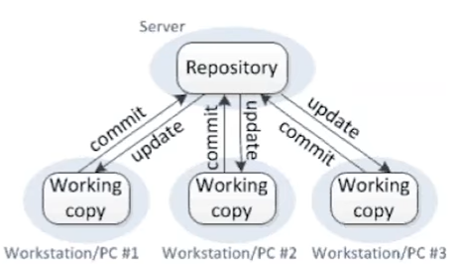
Version control Problem with Client Server Version Control
Client Server version control system works on a centralized model which has a single repository to which user check-in & check-out
Some of the major benefits working with version control system are listed below:
Version control is not available on local system
If the central server get corrupted the entire history is lost
Notes:
Add instructor notes here.

Slide 7
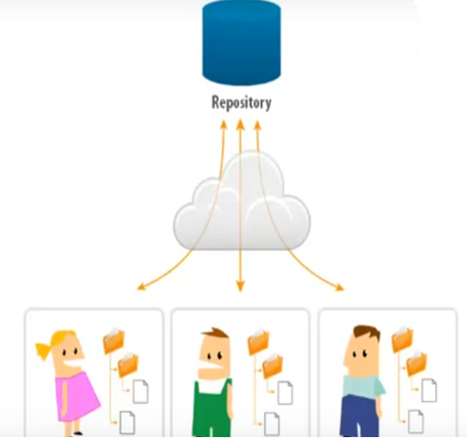
Version control Problem with Client Server Version Control
History in one Repository
Client only gets a single revision per checkout
All commits go into one repository
Notes:
Add instructor notes here.

Slide 8
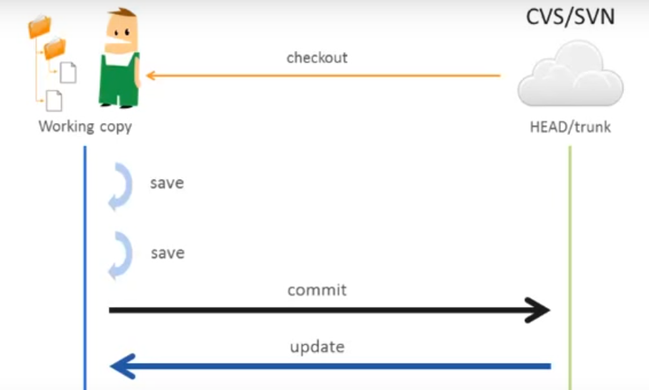
Version control Problem with Client Server Version Control
Notes:
Add instructor notes here.

Slide 9
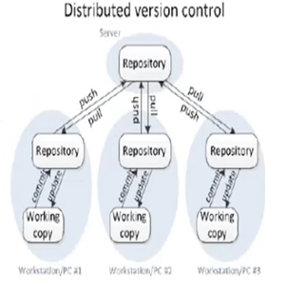
Version control Advantage of Distributed Version Control-GIT
Distributed version control system don’t rely on central server. It allows one of the repository on their own drive with entire history of the project
Benefits of Distributed version control :
DVCS is also available on local machine.
No single point of failure as each user has the repository with entire history
Performs all action locally , even when not connected to internet
Notes:
Add instructor notes here.

Slide 10
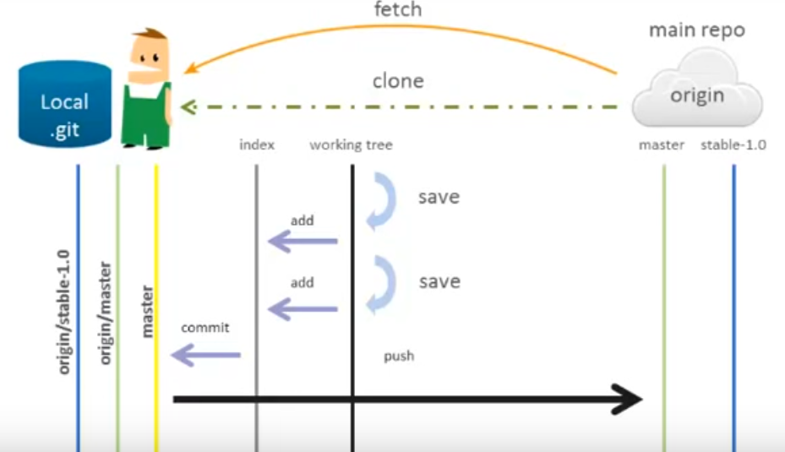
Version control How Distributed Version Control-GIT Works
Notes:
Add instructor notes here.

Slide 11
Version control Version Control Parallel Development -GIT
Version control system helps in parallel development and preventing one user from overwriting the work of another
Two ways to solve parallel development problem:
Copy-modify-merge –GIT uses this
Lock-modify-unlock(practically not possible)
Notes:
Add instructor notes here.

Slide 12
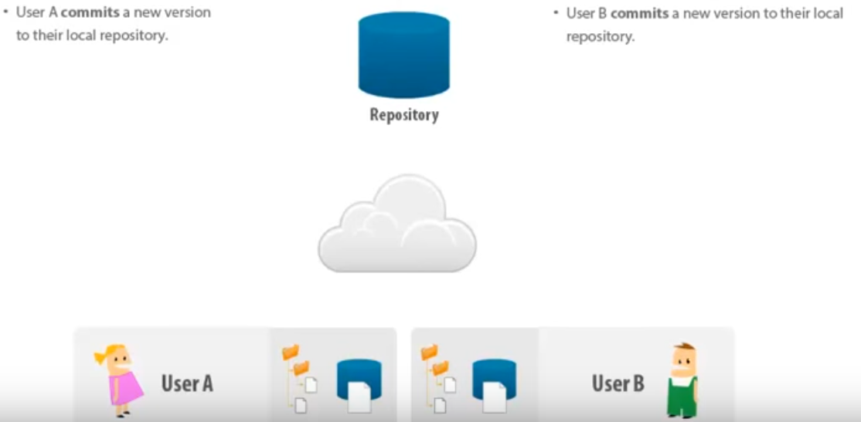
Version control Version Control Parallel Development -GIT
Notes:
Add instructor notes here.

Slide 13
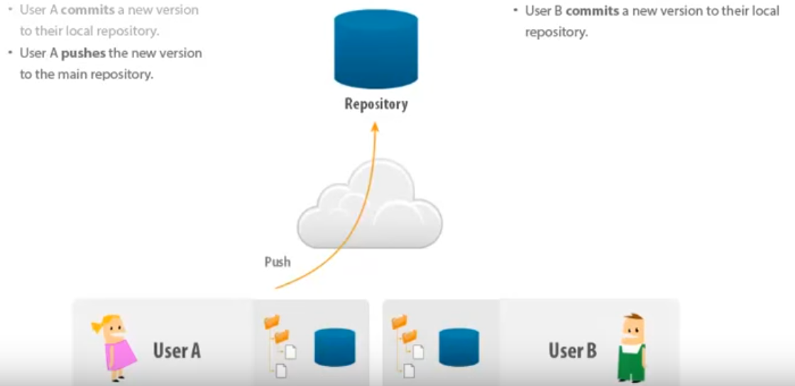
Version control Version Control Parallel Development -GIT
Notes:
Add instructor notes here.

Slide 14
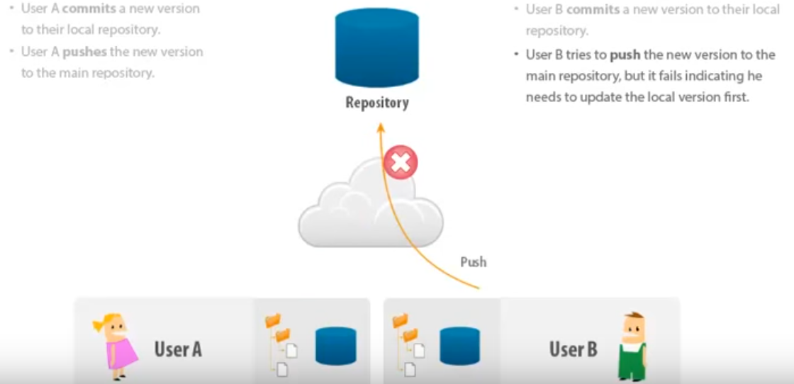
Version control Version Control Parallel Development -GIT
Notes:
Add instructor notes here.

Slide 15
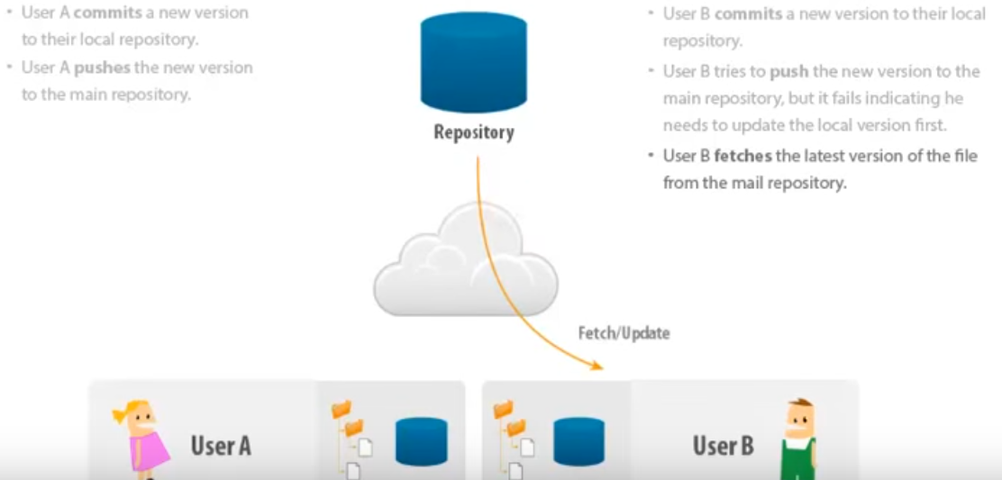
Version control Version Control Parallel Development -GIT
Notes:
Add instructor notes here.

Slide 16
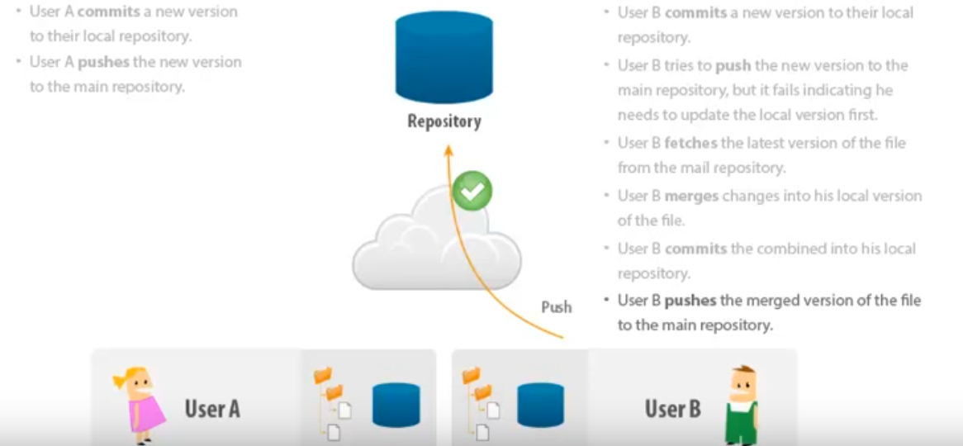
Version control Parallel Development, Copy Modify Merge
Notes:
Add instructor notes here.

Slide 17
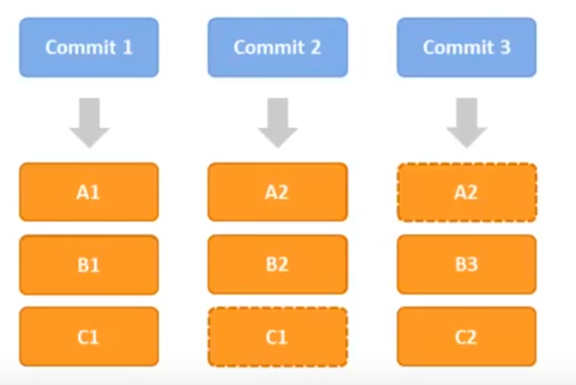
Version control Git – Snapshot Storage
Snapshot Storage –stores the complete files changed by a commit along with references to files that were not changed by that commit.
Notes:
Add instructor notes here.

Slide 18
Repositories and Branches GIT-Repositories
Repositories:
It is a collection of refs together with an object database containing all objects which are reachable from the refs, possibly accompanied by meta data from one or more porcelains. A repository can share an object database with other repositories via alternate mechanism.
What to store in repositories?
Anything, however any sort of editable files are preferred.
Notes:
Add instructor notes here.

Slide 19
Repositories and Branches Git – Snapshot Storage
Creating repositories :
at default location
git init
at particular location
git init c:/testGIT
Bare repository
git init –bare
How to get GIT repository:
$ git clone git://git.kernel.org/pub/scm/git/git.git
It does approx. 225 MB download
Notes:
Add instructor notes here.

Slide 20
Repositories and Branches Repositories and Branches
Branches:
A "branch" is an active line of development.
The most recent commit on a branch is referred to as the tip of that branch.
The tip of the branch is referenced by a branch head, which moves forward as additional development is done on the branch.
A single git repository can track an arbitrary number of branches, but working tree is associated with just one of them (the "current" or "checked out" branch), and HEAD points to that branch
Notes:
A bare repository is normally an appropriately named directory with a .git suffix that does not have a locally checked-out copy of any of the files under revision control. That is, all of the git administrative and control files that would normally be present in the hidden .git sub-directory are directly present in the repository. Git directory instead, and no other files are present and checked out. Usually publishers of public repositories make bare repositories available.
master The default development branch. Whenever you create a git repository, a branch named "master" is created, and becomes the active branch. In most cases, this contains the local development, though that is purely by convention and is not required.
Add instructor notes here.

Slide 21
Repositories and Branches Repositories and Branches
Getting different versions of project:
Git is best thought of as a tool for storing the history of a collection of files. It stores the history as a compressed collection of interrelated snapshots of the project’s contents. In git each such version is called a commit.
Those snapshots aren’t necessarily all arranged in a single line from oldest to newest; instead, work may simultaneously proceed along parallel lines of development, called branches, which may merge and diverge.
A single git repository can track development on multiple branches. It does this by keeping a list of heads which reference the latest commit on each branch; the git-branch(1) command shows you the list of branch heads:
$ git branch * master
A freshly cloned repository contains a single branch head, by default named "master", with the working directory initialized to the state of the project referred to by that branch head.
Most projects also use tags. Tags, like heads, are references into the project’s history, and can be listed using thegit-tag(1) command:
$ git tag -l
Notes:
git branch
List all of the branches in our repository.
git branch <branch>
Create a new branch called <branch>. This does not check out the new branch.
git branch -d <branch>
Force delete the specified branch
git branch -m <branch>
Examples:
It's important to understand that branches are just pointers to commits. When you create a branch, all Git needs to do is create a new pointer—it doesn’t change the repository in any other way.
create a branch using the following command:
git branch branch-experiment
The repository history remains unchanged. All you get is a new pointer to the current commit
Once we are finished working on a branch and have merged it into the main code base, we are free to delete the branch without losing any history
git branch -d branch-experiment
However, if the branch hasn’t been merged, the above command will output an error message
git checkout <existing-branch>
Check out the specified branch, which should have already been created with git branch. This makes <existing-branch> the current branch, and updates the working directory to match.
git checkout -b <new-branch>
Create and check out <new-branch>. The -b option is a convenience flag that tells Git to run git branch <new-branch> before running git checkout <new-branch>. git checkout -b <new-branch> <existing-branch>
Same as the above invocation, but base the new branch off of <existing-branch> instead of the current branch.
Add instructor notes here.

Slide 22
Repositories and Branches Understanding History-Repositories
Commits:
Every change in the history of a project is represented by a commit. The git-show(1) command shows the most recent commit on the current branch:
$ git show
Every commit (except the very first commit in a project) also has a parent commit which shows what happened before this commit. Following the chain of parents will eventually take you back to the beginning of the project.
However, the commits do not form a simple list; git allows lines of development to diverge and then reconverge, and the point where two lines of development reconverge is called a "merge". The commit representing a merge can therefore have more than one parent, with each parent representing the most recent commit on one of the lines of development leading to that point.
The best way to see how this works is using the gitk(1)command; running gitk now on a git repository and looking for merge commits will help understand how the git organizes history.
In the following, commit X is "reachable" from commit Y if commit X is an ancestor of commit Y. Equivalently, Y is a descendant of X, or that there is a chain of parents leading from commit Y to commit X.
Notes:
Add instructor notes here.

Slide 23
Repositories and Branches Understanding History-Trees
The working tree is the current view into the repository. It has all the files from your project: the source code, build files, unit tests, and so on.
Some VCSs refer to this as your working copy. People coming to Git for the first time from another VCS often have trouble separating the working tree from the repository. In a VCS such as Subversion, your repository exists “over there” on another server.
In Git, “over there” means in the .git/ directory inside your project’s directory on your local computer. This means you can look at the history of the repository and see what has changed without having to communicate with a repository on another server.
Notes:
Add instructor notes here.

Slide 24
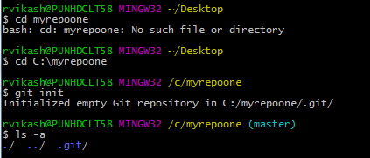
Working Locally with GIT Locally Working with GIT
Download GIT From
https://git-scm.com/downloads
First Repository :
Create Empty directory on system myrepoone
Create a repository
git init
Checking repository created or not
Notes:
Add instructor notes here.

Slide 25
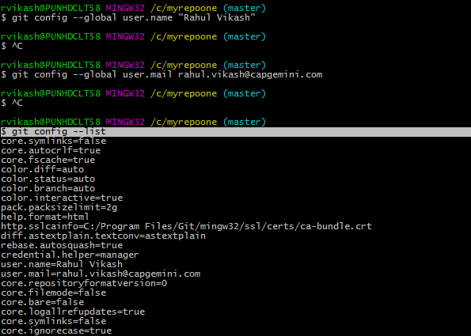
Working Locally with GIT Locally Working with GIT
Setting Name & email Id
Setting name
git config --global user.name "Rahul Vikash"
Setting email
$ git config --global user. Mail rahul.vikash@capgemini.com
Checking configuration
$ git config –list
Notes:
Add instructor notes here.

Slide 26
Working Locally with GIT Locally Working with GIT
Adding File in repository
MyFirst.txt
Check
$ ls
Know the status
$ git status
Add the file in staging
$ git add MyFirst.txt
Commit in git repository with lock message
$ git commit -m "Added MyFirst File“
See log
$ git log
Notes:
Add instructor notes here.

Slide 27
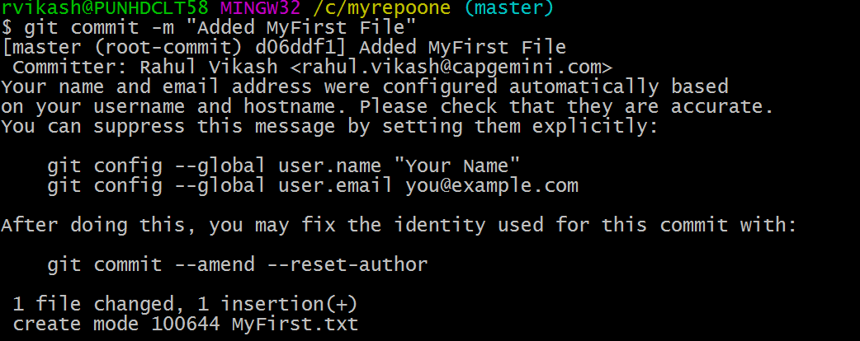
Working Locally with GIT Locally Working with GIT
Notes:
Add instructor notes here.

Slide 28
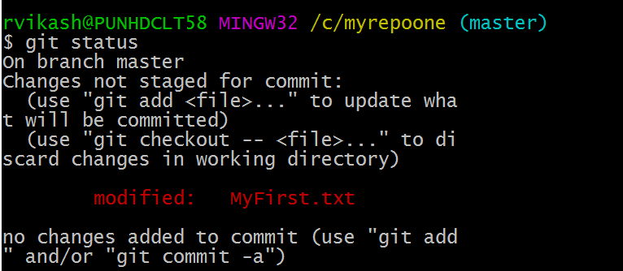
Working Locally with GIT Locally Working with GIT-
Adding new data in MyFirst.txt
Now checking status $git status
Commit $ git commit -am "Added New MyFirst File“
Again check log --$git log
Notes:
Add instructor notes here.

Slide 29
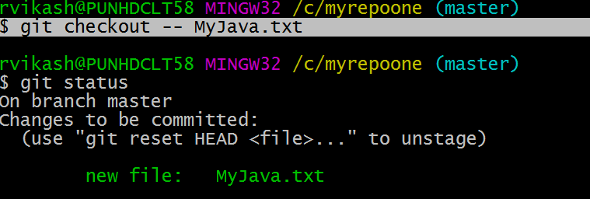
Working Locally with GIT Locally Working with GIT-
To check which line has changed
$ git commit - -amend
Add one more file –MyJava.txt
Unstage the One File
$ git reset HEAD MyFirst.txt
Unchanged the work done --$ git checkout -- MyJava.txt
Notes:
Add instructor notes here.

Slide 30
Working Locally with GIT Locally Working with GIT
Multiple Reset for n number of file ,Goes to last commit
$ git reset -- hard
Notes:
Add instructor notes here.

Slide 31
Working Remotely with GIT Remotely Working with GIT
Adding MyFirst.Java in Remote Repository
Create account in : https://github.com
$ git init
$ git add MyFirst.java
$ git commit -m "first commit"
$ git remote add origin https://github.com/rahulviki86/basicdemo.git
$ git push -u origin master
User ID
Repository Name
Notes:
git clone rahul.vikash@capgemini.com:myrepoone
git-remote - Manage set of tracked repositories, Manage the set of repositories ("remotes") whose branches you track.
git-push - Update remote refs along with associated objects, Updates remote refs using local refs, while sending objects necessary to complete the given refs.
git-fetch - Download objects and refs from another repository
git-pull - Fetch from and integrate with another repository or a local branch
git-merge - Join two or more development histories together
Add instructor notes here.

Slide 32
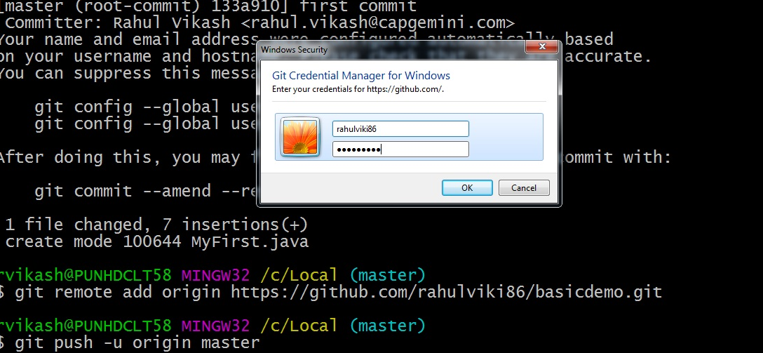
2.5: Working Remotely with GIT Remotely Working with GIT
After running
$ git push -u origin master – Ask for username & Password

Slide 33
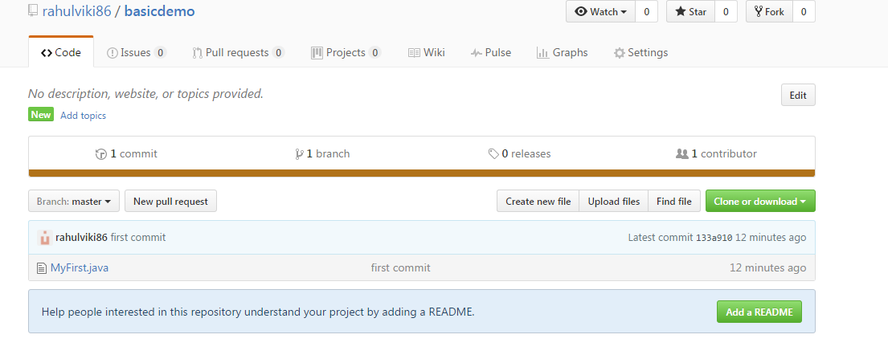
Working Remotely with GIT Remotely Working with GIT
Added in the Remote Repository

Slide 34
Working Remotely with GIT Remotely Working with GIT
Cloneing the data ----git clone <repo> <directory>
When you run git clone, the following actions occur:
A new folder called repo is made
It is initialized as a Git repository
A remote named origin is created, pointing to the URL you cloned from
All of the repository's files and commits are downloaded there
The default branch (usually called master) is checked out
For every branch foo in the remote repository, a corresponding remote-tracking branch refs/remotes/origin/foo is created in your local repository. You can usually abbreviate such remote-tracking branch names to origin/foo.
Syntax:
$git clone https://github.com/rahulviki86/basicdemo.git
Notes:
Add instructor notes here.

Slide 35
Working Remotely with GIT Remotely Working with GIT
git-fetch - Download objects and refs from another repository, Use git fetch to retrieve new work done by other people. Fetching from a repository grabs all the new remote-tracking branches and tags without merging those changes into your own branches.
Syntax:
$git fetch remotename
git-pull - Fetch from and integrate with another repository or a local branch, is a convenient shortcut for completing both git fetch and git merge in the same command.
Syntax:
$git pull remotename branchname
Notes:
Add instructor notes here.

Slide 36
Working Remotely with GIT Remotely Working with GIT
git-merge - Join two or more development histories together.Merging combines your local changes with changes made by others.
Syntax:
$git merge remotename/branchname
Notes:
Add instructor notes here.

Slide 37
Demo
Demo on GIT –Locally using git init, add, status, log
Demo on GIT- Remotelly using git remote, pull, push, fetch, clone
Notes:
Add the notes here.
Add instructor notes here.

Slide 38
Lab
Lab 01,02
Notes:
Add the notes here.
Add instructor notes here.

Slide 39
Summary
Git is a distributed revision control and source code management (SCM) system with an emphasis on speed, data integrity and support for distributed, non-linear workflows.
Git working with local repository
Git working with remote repository
Notes:
Add the notes here.
Add instructor notes here.

Slide 40
Review Question
To see the difference between which two branches the following command can be used?
git diff master branch_name
git --diff master branch_name
git merge master branch_name
git --stat master branch_name
The git _____ command performs a git fetch and git merge.
Push
Pull
Clone
branch
Notes:
Add the notes here.
Q1 git diff master branch name
Q2 pull
Q3

Slide 41
Review Question
Three files file1,file2 and file3 are modified. Identify the series of commands to view the modified files,
then add their updated contents to the index and commit the changes.
'$ git status ->$ git commit
$ git diff –cached->$ git status->$ git commit –a
$ git add ->$ git diff –cached->$ git status->$ git commit
$ git add file1 file2 file3->$ git diff –cached->$ git status->$ git commit
Notes:
Add the notes here.
Q3 $ git add file1 file2 file3->$ git diff –cached->$ git status->$ git commit

